Slide 1
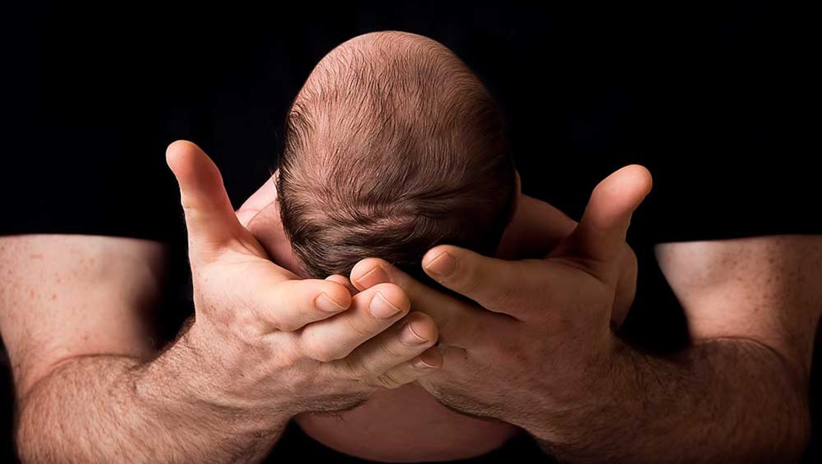

Slide 2

Psalm 149:4 New King James Version (NKJV)
For the Lord takes pleasure in His people;
He will beautify the [a]humble with salvation.

Slide 3
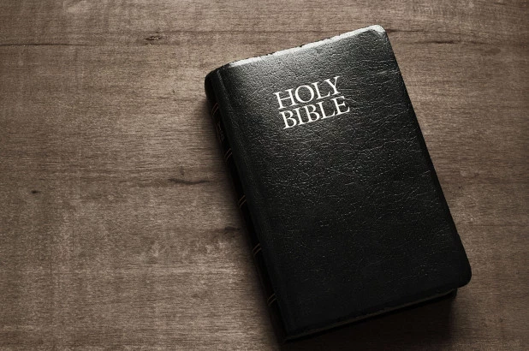
Revelation 4:10-11 (NKJV)
10 the twenty-four elders fall down before Him who sits on the throne and worship Him who lives forever and ever, and cast their crowns before the throne, saying:
11 “You are worthy, [a]O Lord, To receive glory and honor and power; For You created all things, And by Your will they [b]exist and were created.”

Slide 4
Created for God’s Glory
Psalm 149:4, Revelation 4:10-11
Pastor. Rod Lago

Slide 5

“We exist for His benefit, His Glory, His Purpose, and His Delight.”

Slide 6

John 4:23 New King James Version (NKJV)
But the hour is coming, and now is, when the true worshipers will worship the Father in spirit and truth; for the Father is seeking such to worship Him.

Slide 7
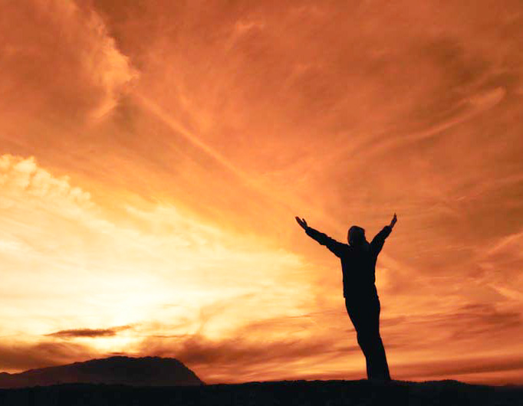
“Worship is our Eternal Calling to God that we will do from Here to Eternity.”

Slide 8
What are the three Primary aspects of Worship?

Slide 9

I. Worship is Far more than Music.

Slide 10
Common misuse of the term “Worship”
PRAISE – means Fast Songs, Happy and Lively Songs.
WORSHIP – Slow Songs.

Slide 11
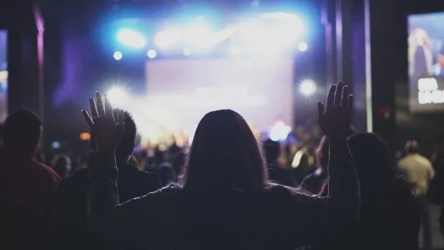
“Because anything we do that brings Glory to God is an Act of Worship.”

Slide 12
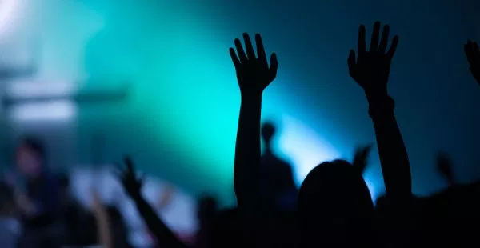
II. Worship is not for your Benefit.

Slide 13
Isaiah 29:13 (NIV)
The Lord says:
“These people come near to me with their mouth and honor me with their lips, but their hearts are far from me. Their worship of me is based on merely human rules they have been taught.

Slide 14

“God’s heart is not touched by Tradition in Worship, but by Passion and Commitment.”

Slide 15
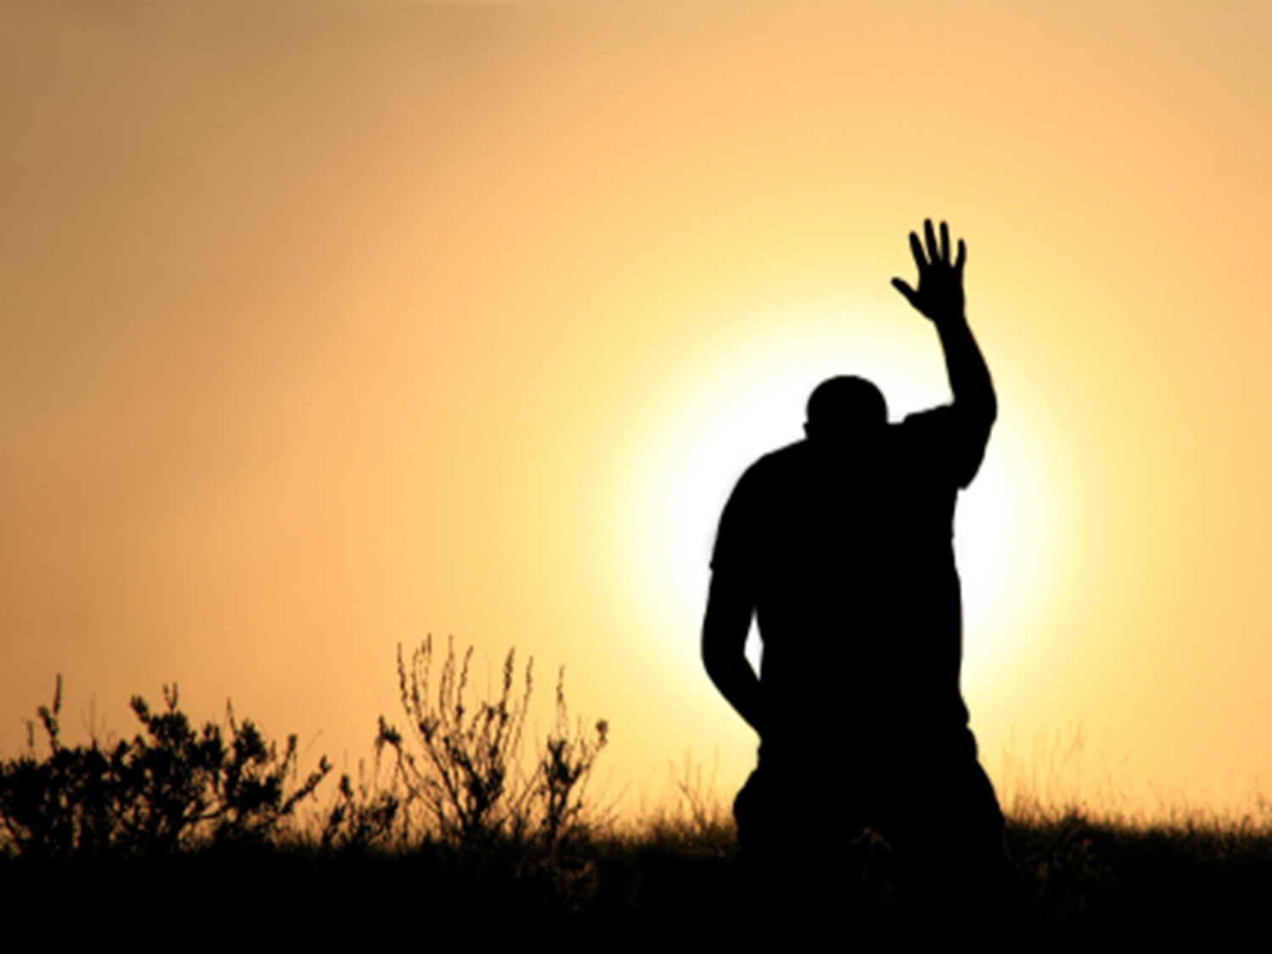
“If your Worship doesn’t leads you to love God more above anything in this world you are missing the line of being a True worshipper of God.”

Slide 16

“Worship is not for Us it is for God and our Motive is to bring Glory and Honor to the Living God.”

Slide 17
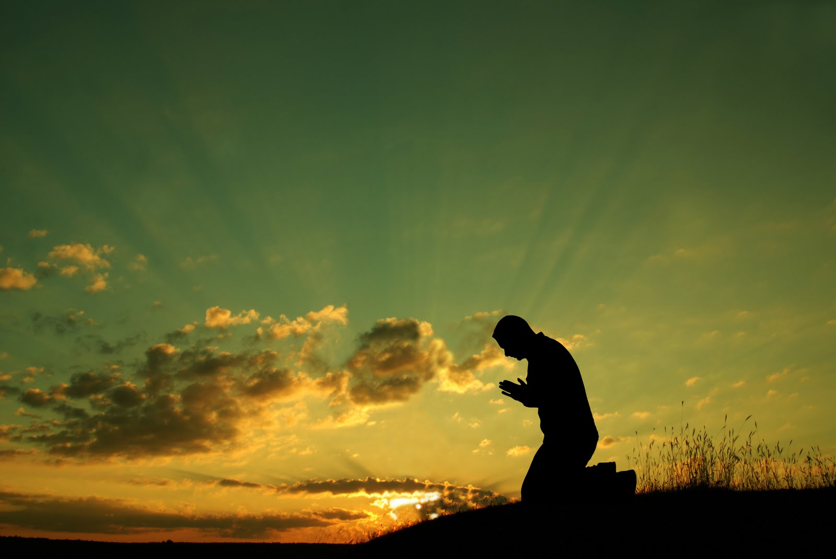
III. Worship is not Part of your life, it is your Life.

Slide 18
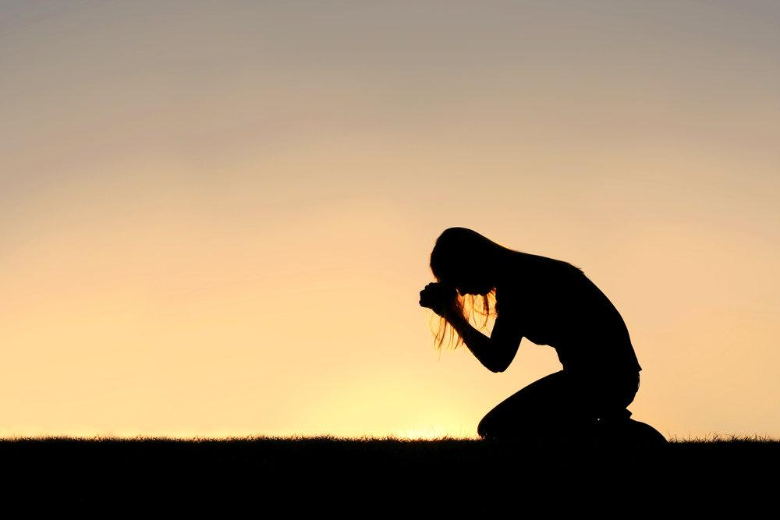
“Worship must be the first activity when you open your eyes in the morning and the last activity when you close them at night.”

Slide 19
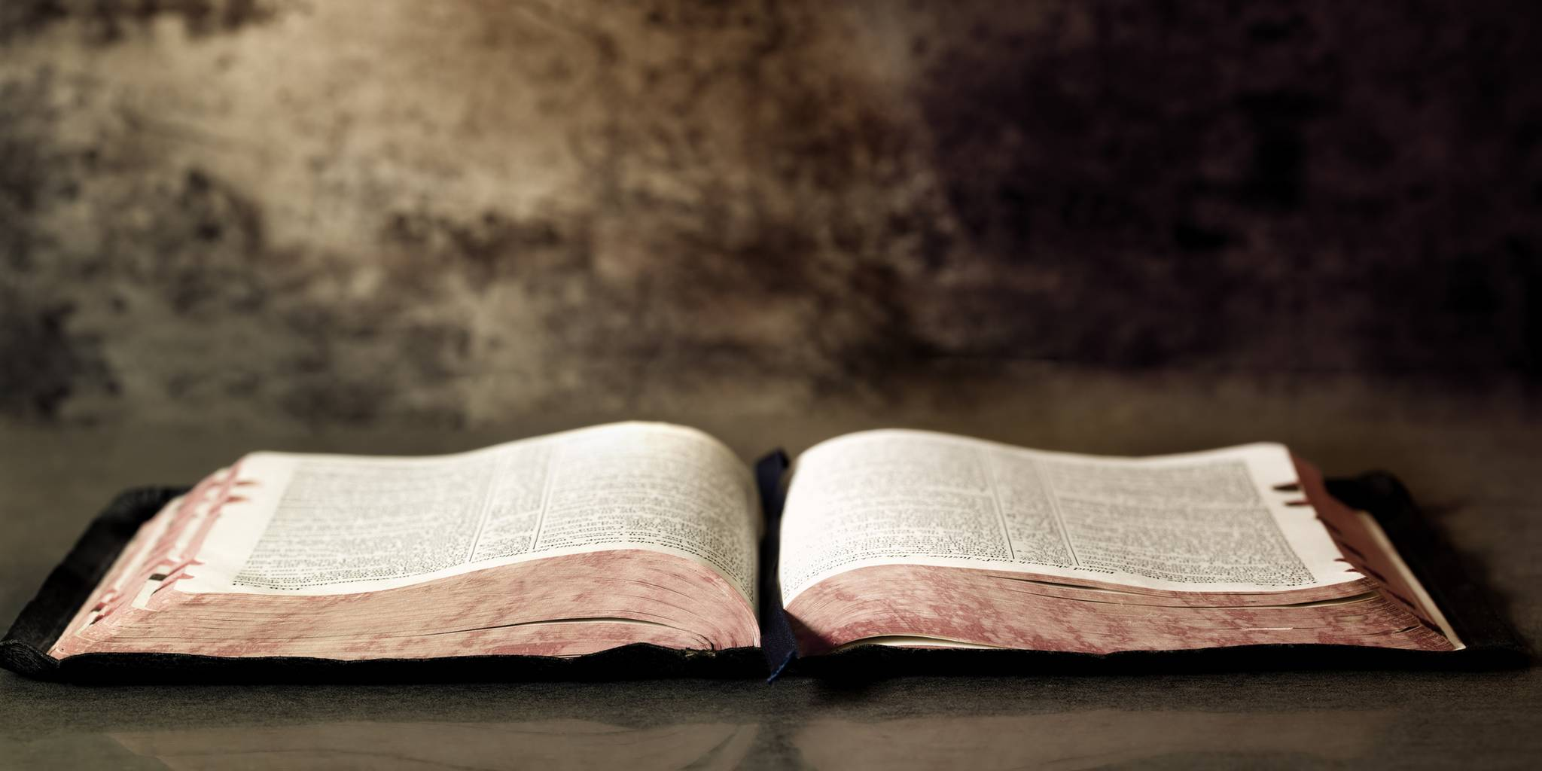
1 Corinthians 10:31(NIV)
So whether you eat or drink or whatever you do, do it all for the glory of God.

Slide 20

“Every Activity can be Transformed into an Act of Worship when you do it for the Glory of God.”

Slide 21
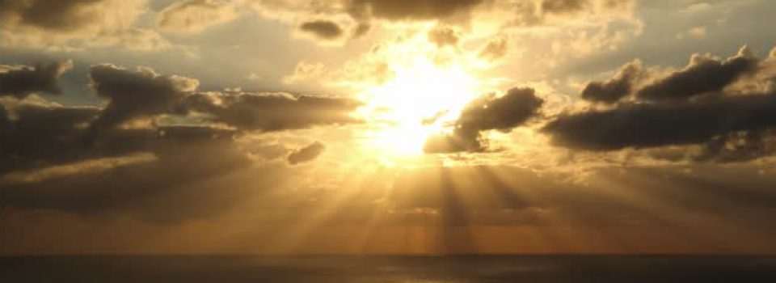
Colossians 3:23(NIV)
Whatever you do, work at it with all your heart, as working for the Lord, not for human masters,

Slide 22
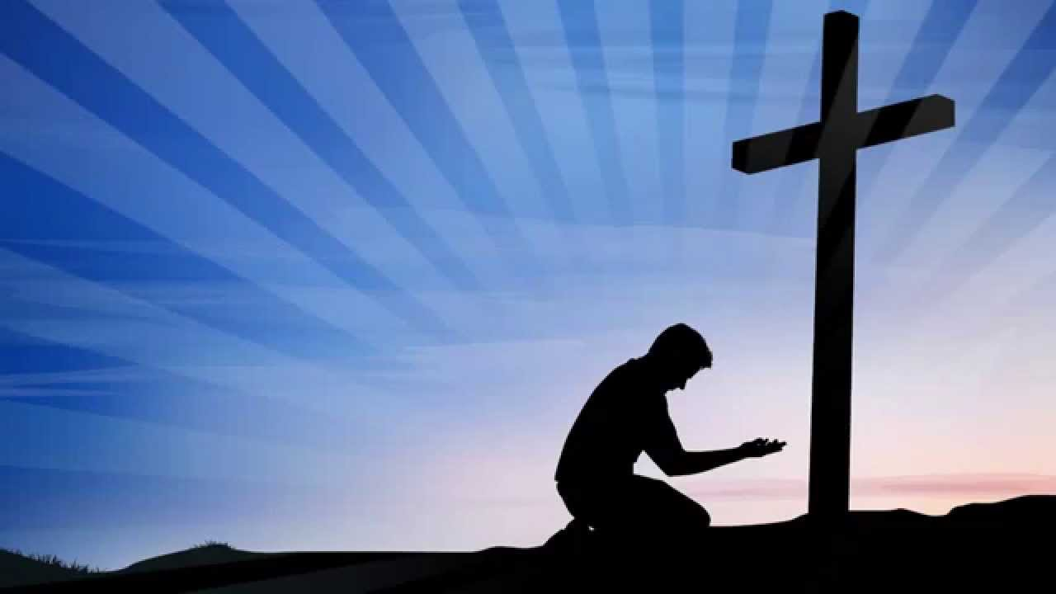
“Real Worship is Falling in love with Jesus.”

